Slide 1
RF Direction Detection Team R
Final Demo
Sylvie Sorese, Ryan Clayton, Dalton Mitchum, Robert Kramer & Krishna Patel
Notes:
202

Slide 2
Goal
The design of an affordable system that detects the direction of arrival of a radio frequency (RF) propagating wave, in the ISM band, with the intention of eventually being used in a classroom setting.

Slide 3
Sprint Review
Finalized PCB board footprints in .dxf formatting for manufacturing process
Printed SPDT and SP4T switch PCB Boards
Assembled the SPDT switch using various RF manufacturing tools in MicaPlex
Tested SPDT switch PCB board on the VNA
Integrated all software subsystems

Slide 4
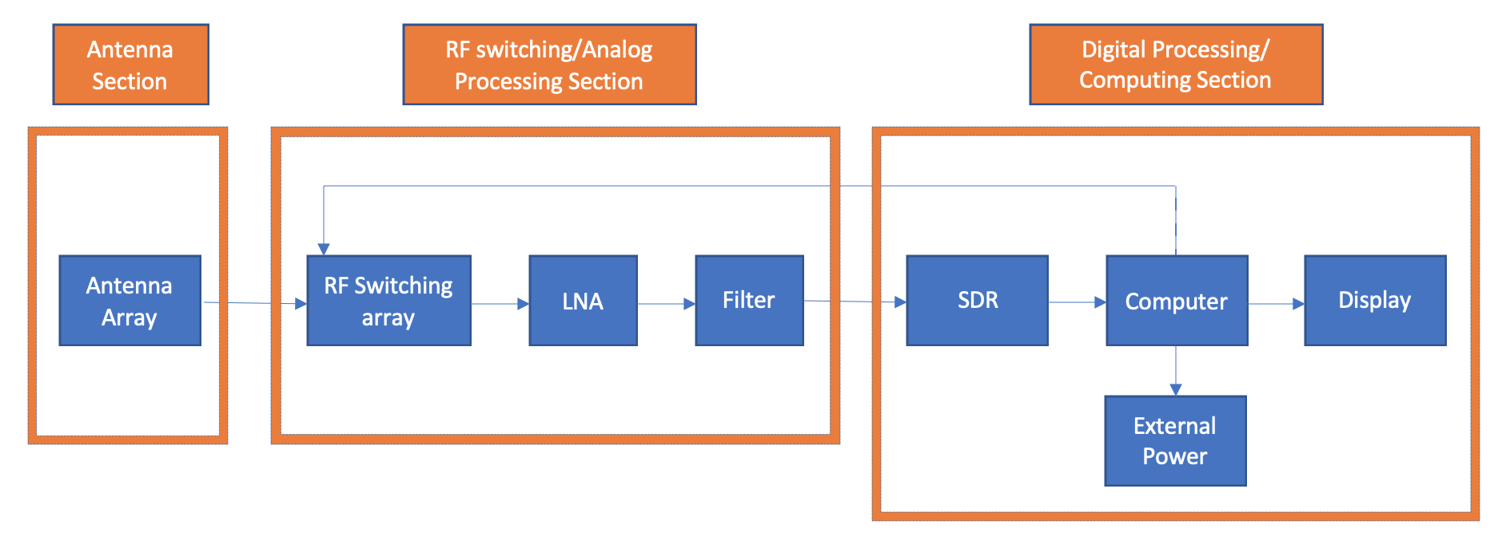
System Layout

Slide 5
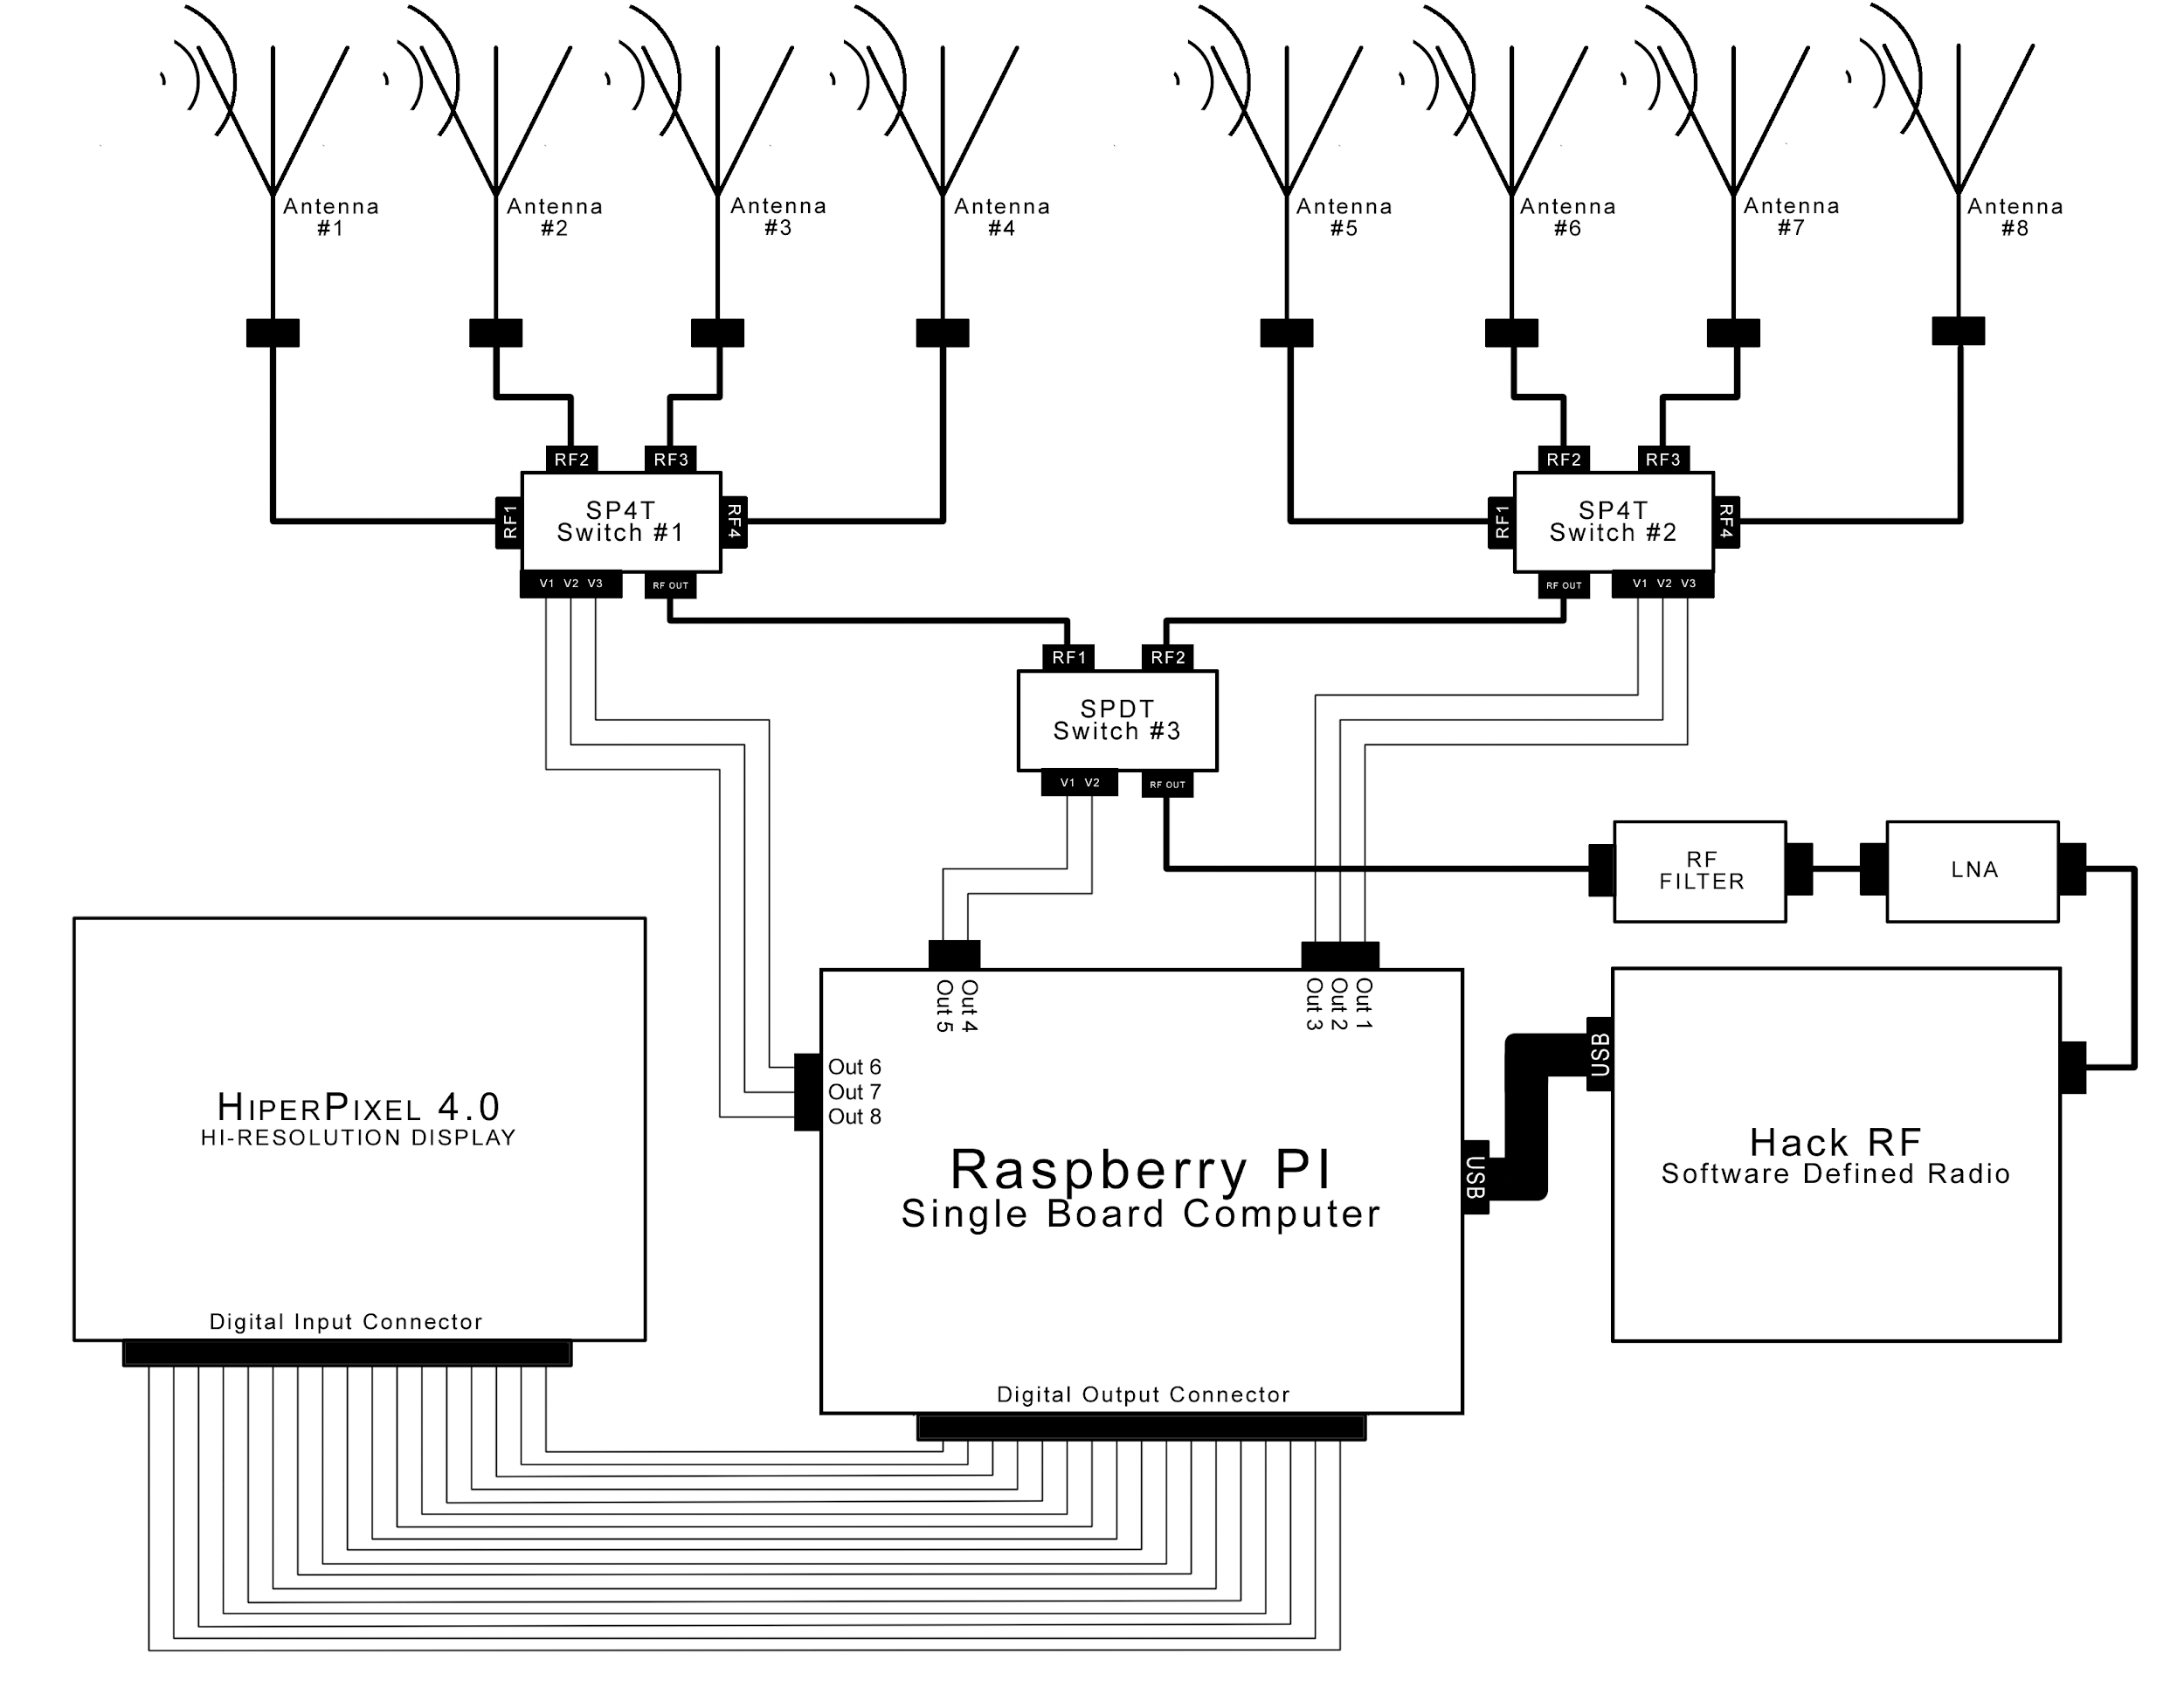
Schematic of System

Slide 6
Ryan Clayton
Acted as Scrum Team Member, RF Engineer and Software Engineer.
Utilized Python coding language to build the direction of arrival calculation software.
Designed 3D antenna array in the HFSS Software.
Made adjustments, simulated and produced gain plots of antenna.
Build 3D antenna ray utilizing copper sheeting and 5 GHz monopole antennas.
Utilized CAD software to design and 3D print an antenna mount for the anechoic chamber.
Utilized anechoic chamber to measure the newly constructed antenna array.
Collected gain plots of the antenna.
Utilized ADS to design transmissions line layout for SPDT and SP4T switches.
Performed simulations of the PCB’s to ensure proper transmission of desired signal.
Generated PCB board layouts for both switch boards utilizing ADS.
Transferred PCB board layouts to the LPKF laser printer in .dxf formatting.
Prepared files in the LPKF suite and printed boards.
Utilized pick and place manufacturing techniques to place both solder paste and micro components on PCB boards.
Baked boards to flow the paste and physically make connections on the boards.

Slide 7
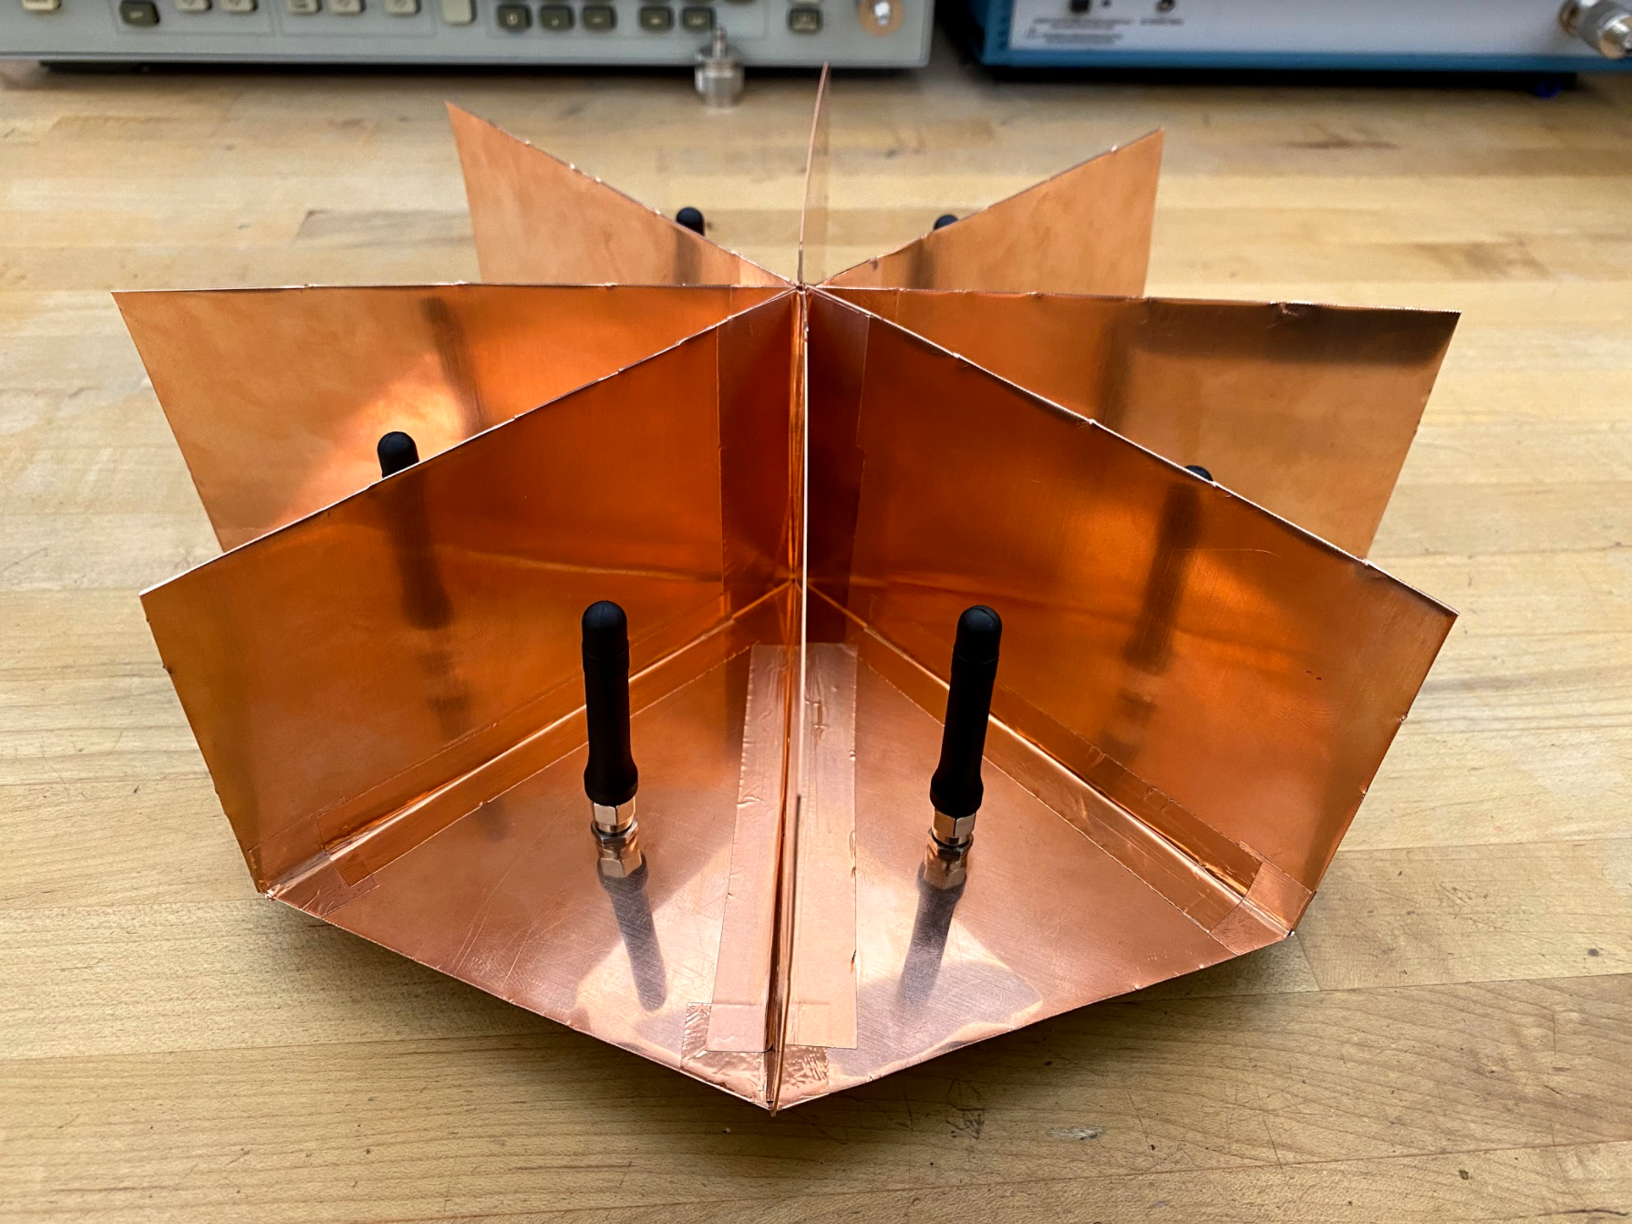
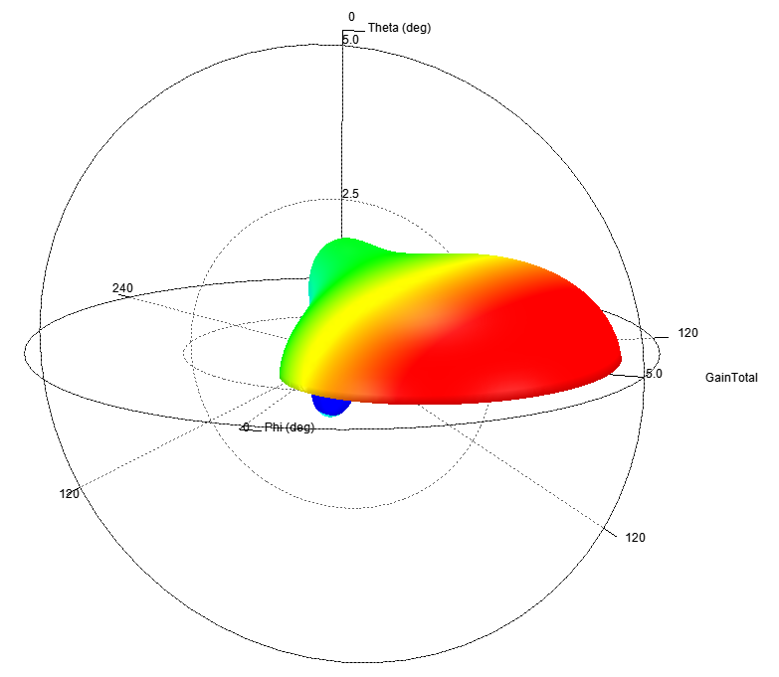
8 Corner Monopole Antenna Array

Slide 8
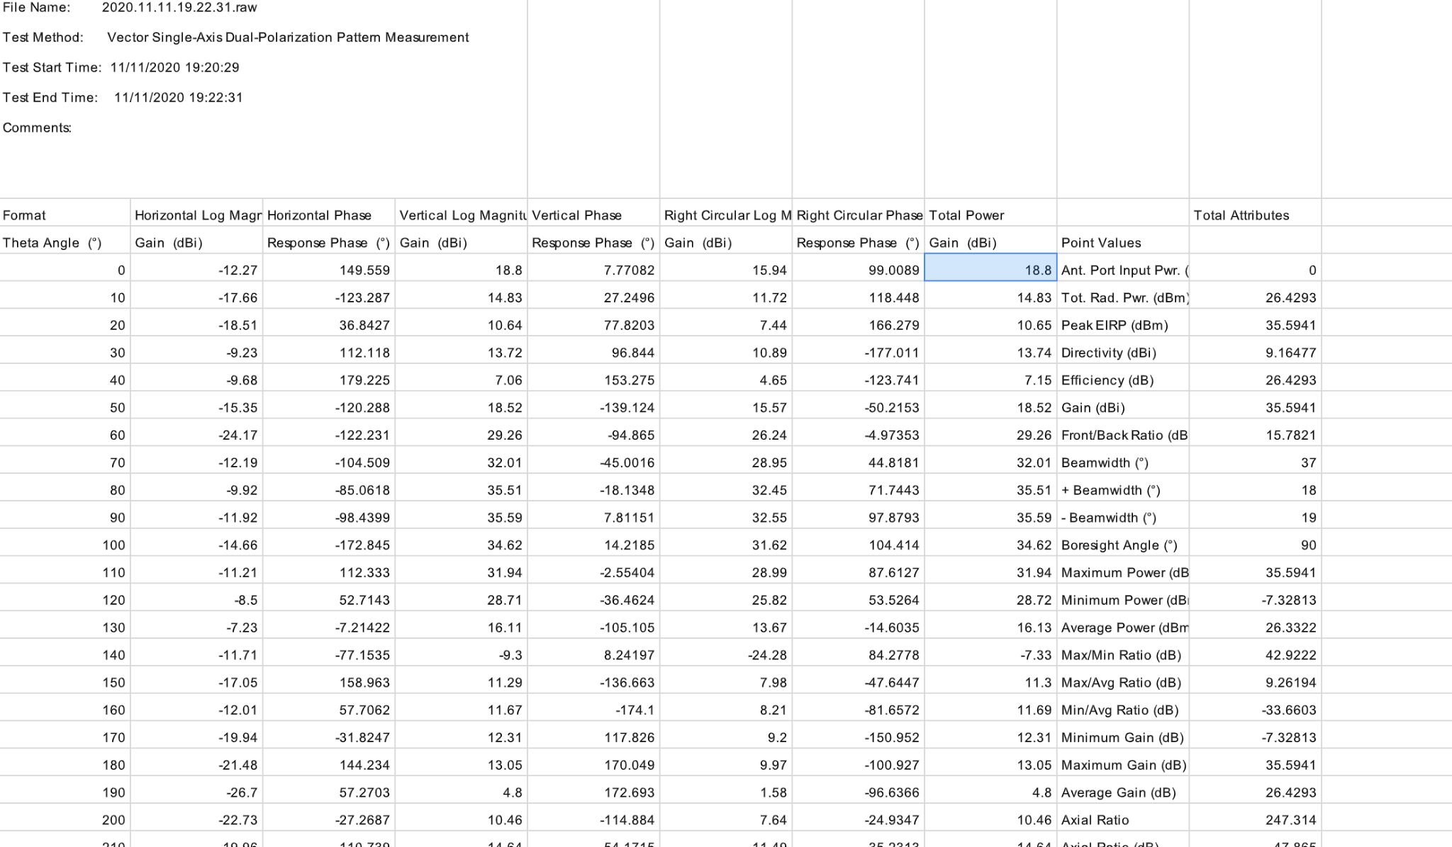

Slide 9
Sylvie Sorese
Acted as Scrum Team Member and RF Engineer
Designed transmissions lines for SPDT and SP4T switches
Designed schematic in ADS for SPDT and SP4T switches
Performed simulations of schematics to ensure low loss and matching at 5 GHz
Aided Ryan in the PCB layout design and manufacturing of the PCBs
Worked with Ryan for testing of the SPDT switch

Slide 10
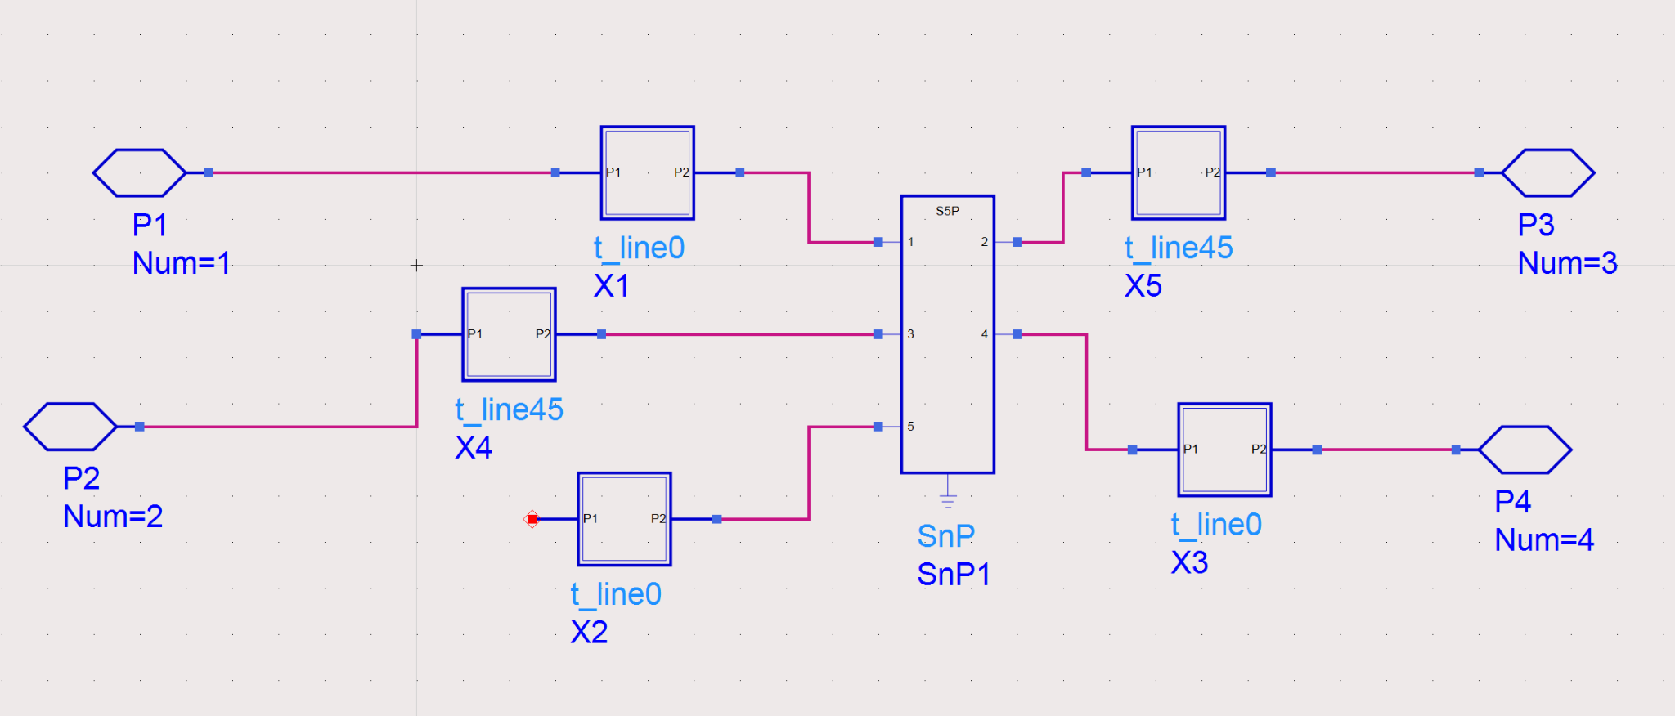
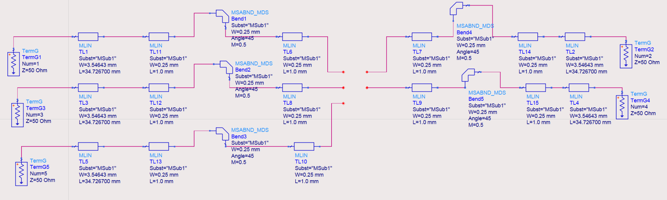
Design Schematics for Simulations

Slide 11
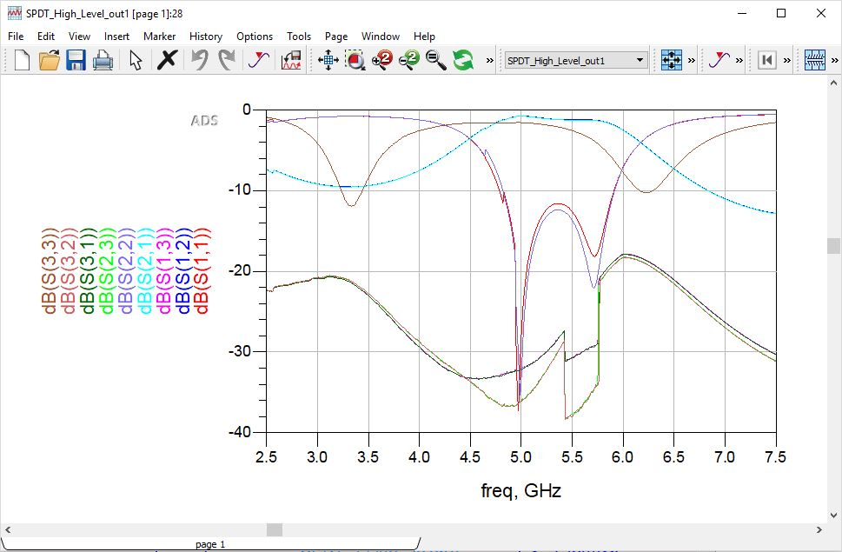
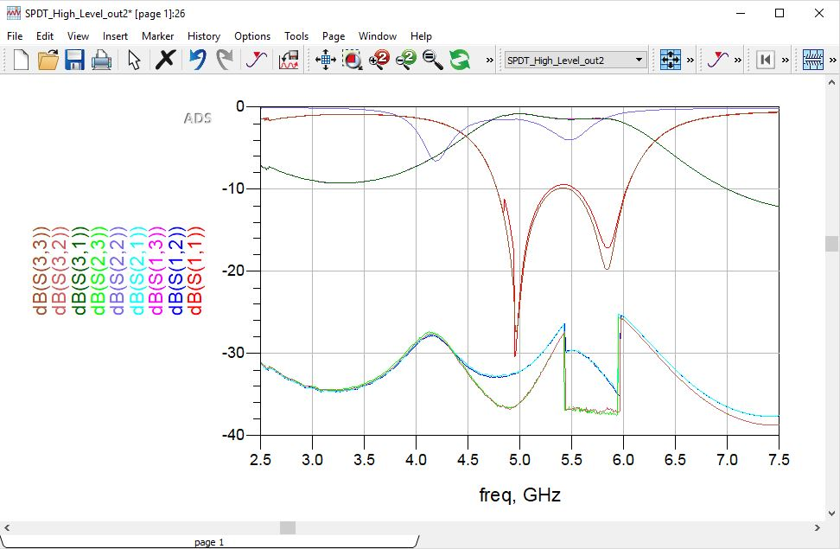
S-Parameter Response of Design

Slide 12
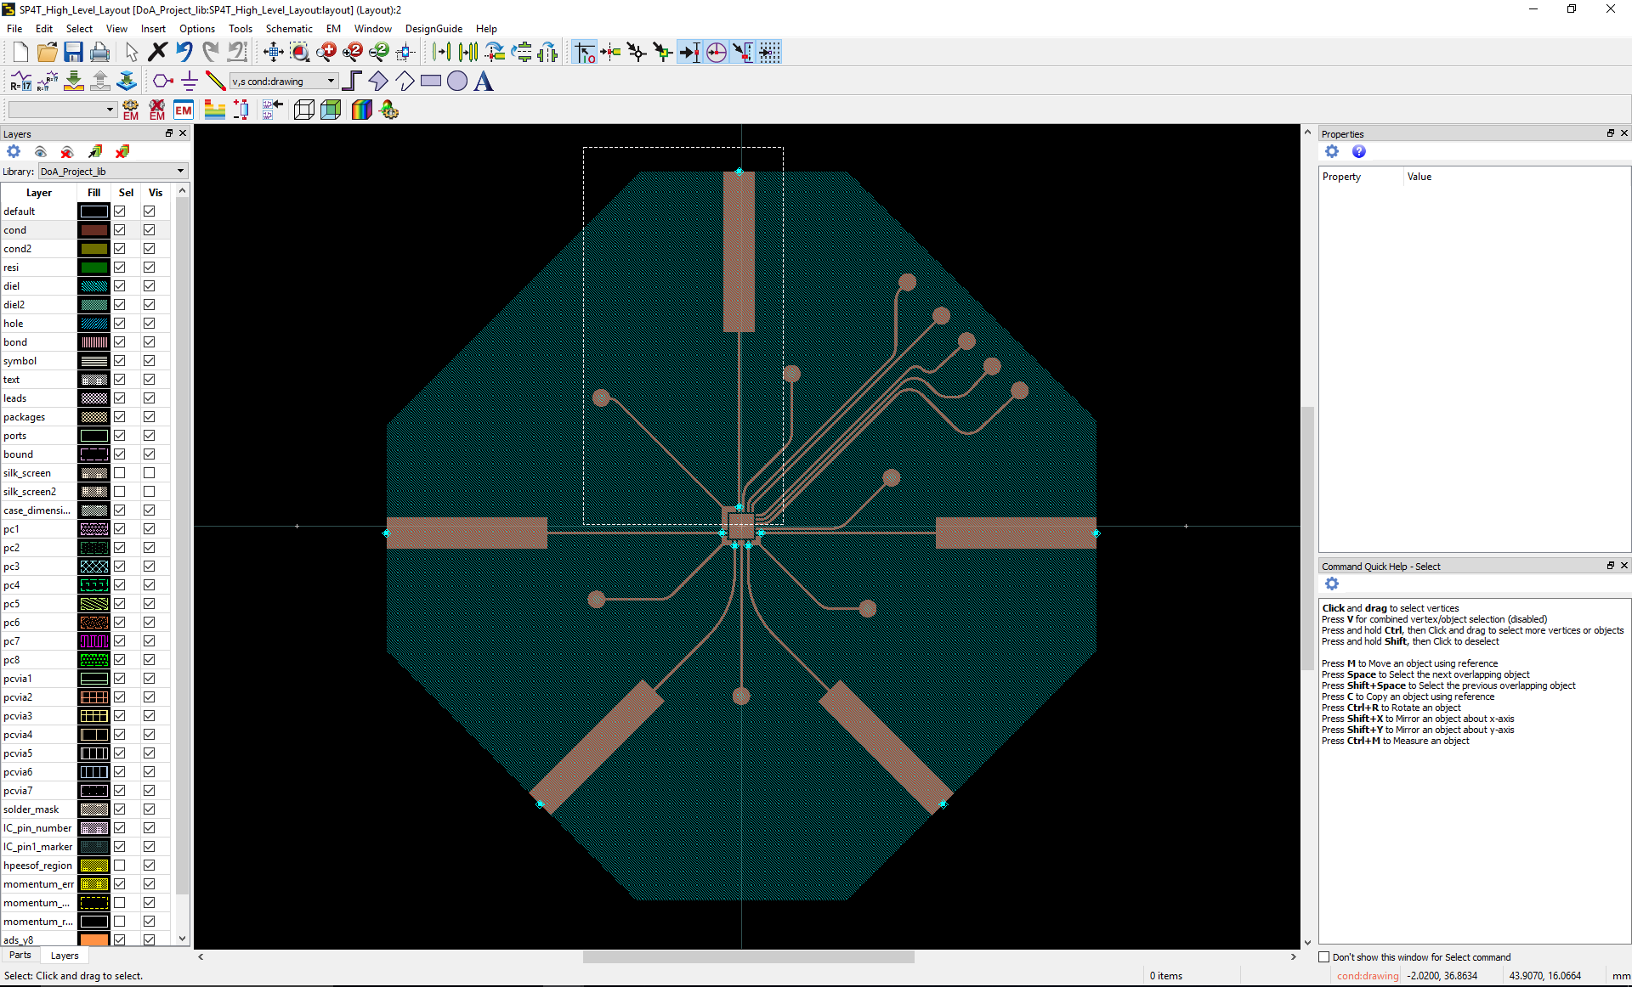
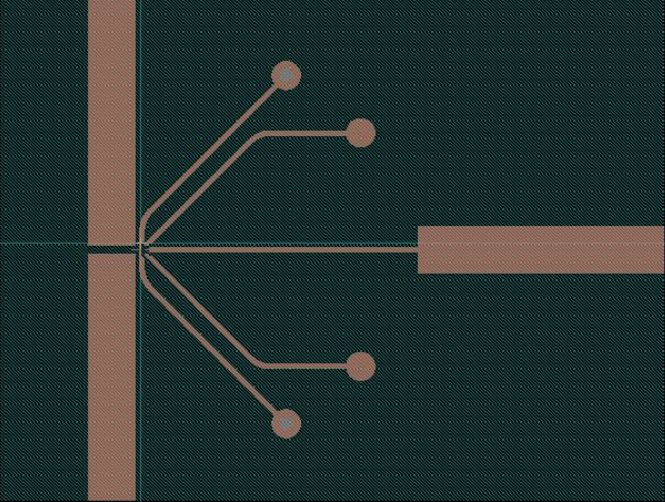
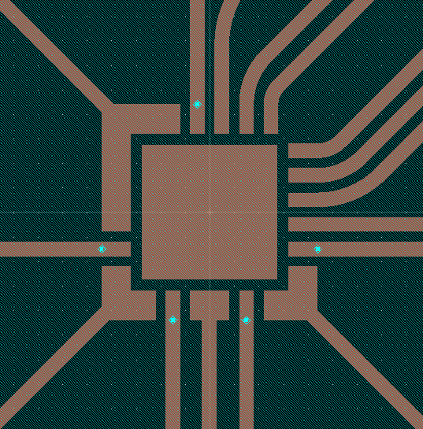
Next Step: PCB Manufacturing
SP4T
SPDT

Slide 13
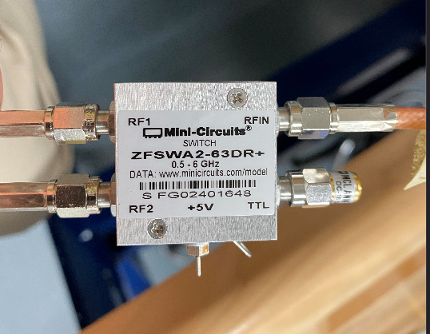
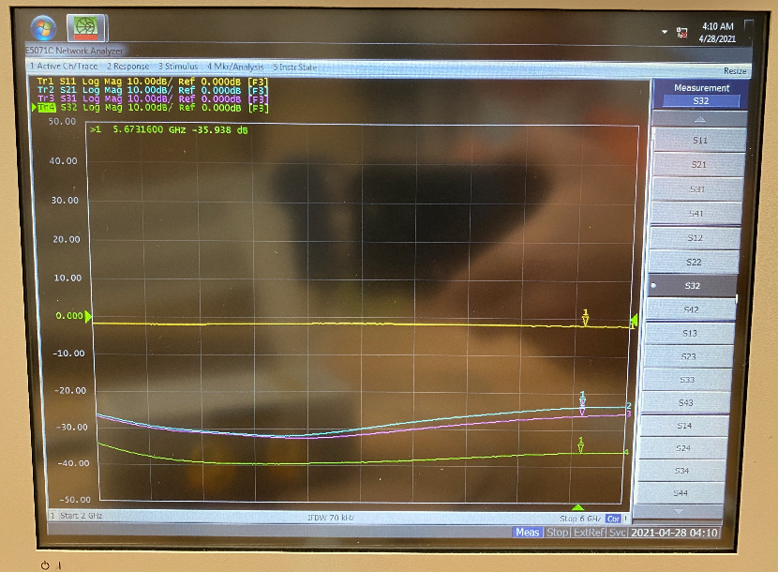
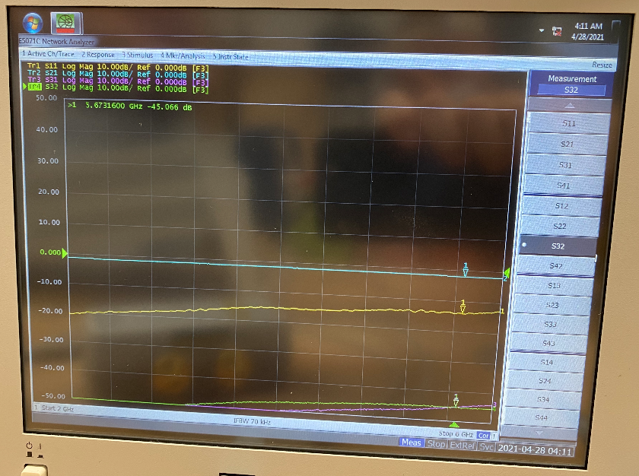
Single-Pole Double Throw Switch

Slide 14
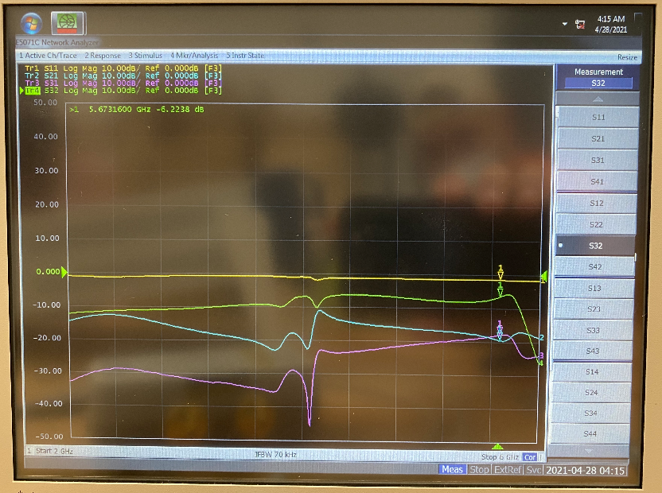
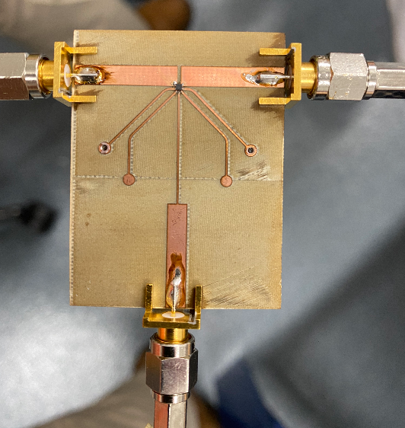
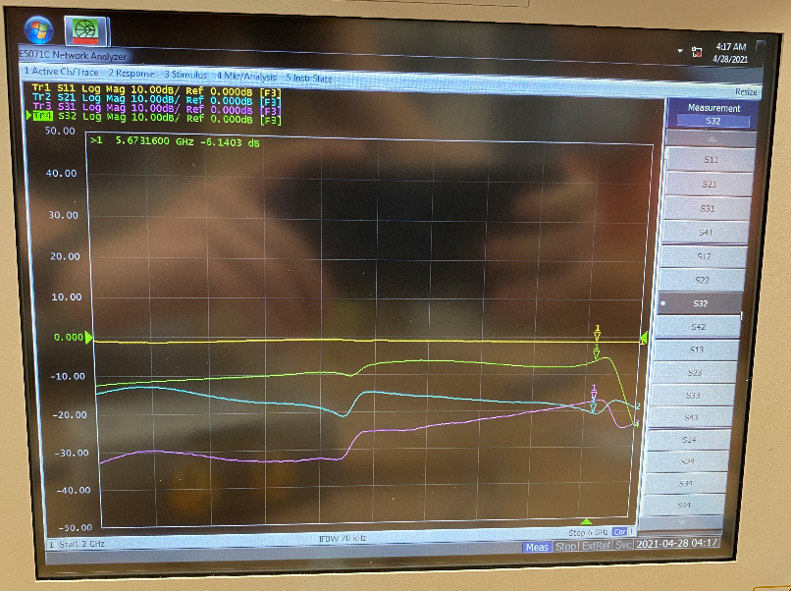
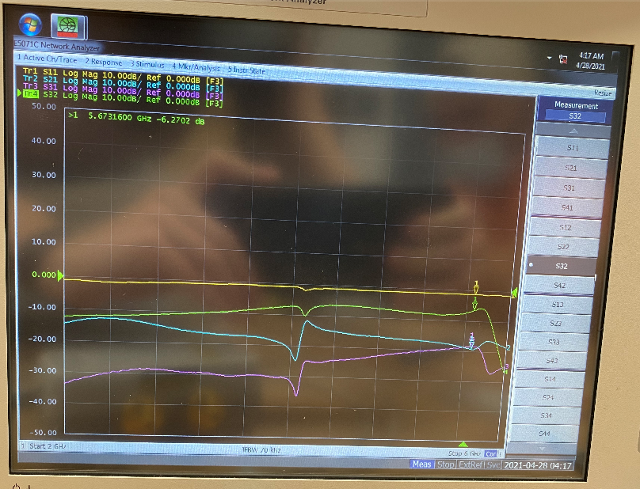
Single-Pole Double Throw Switch (Cont)

Slide 15
Robert Kramer
Acted as Scrum Team Member and Developer
Initial setup of Raspberry Pi 4
Antenna Switching Code
Running on Raspberry Pi
Utilizing GPIO pins
Cycle through each antenna
Integrated full code into one piece with Krishna
Antenna Switching code
Conversion from binary code
Direction Calculation code
GUI code

Slide 16
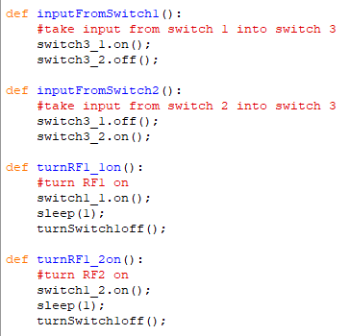
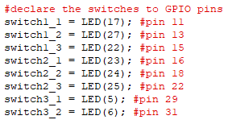
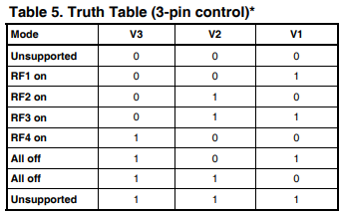
Antenna Switching
Antenna switches are linked to different “LEDs” which are linked to specific pins on the Pi
Switches cycle through the Truth Table which cycles through all 8 antennas

Slide 17
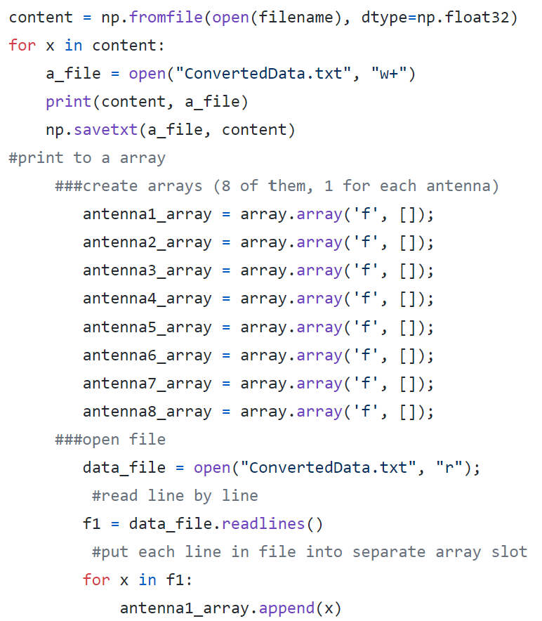
Code Integration
Cycled through all 8 antennas
GNU Radio obtained data for each antenna
Conversion code converts data from binary
Took converted data and put it into 8 different arrays
Averaged the data in the arrays in order to provide usable values for the calculations
Printed angle determined from calculations

Slide 18
Krishna Patel
Acted as Scrum Team Member and Developer
GNU Radio Code
Connecting with the HackRf One
Audio file
Record data
Display signal
Conversion files
Binary data to floating point 1D array
Code Integration with Robert
Direction Calculation code
GUI code
Documentation
SRS, SDS, Test Plan

Slide 19
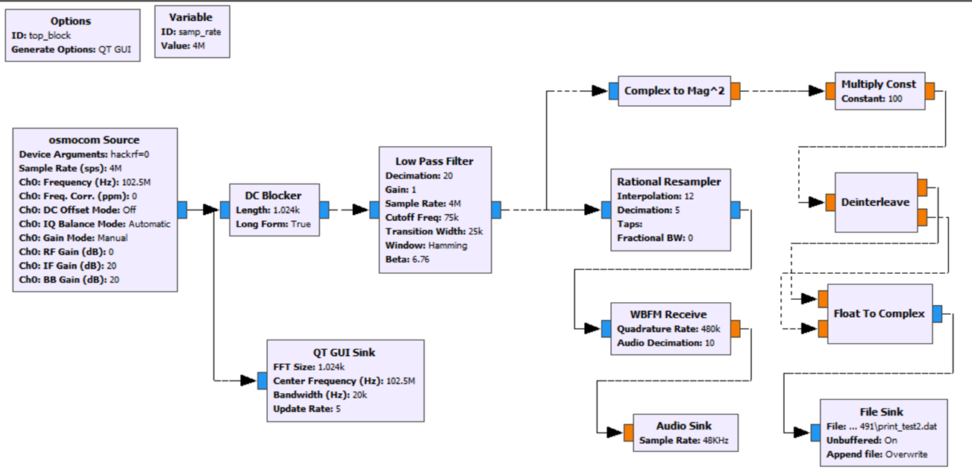
GNU Radio & HackRf One (SDR)

Slide 20
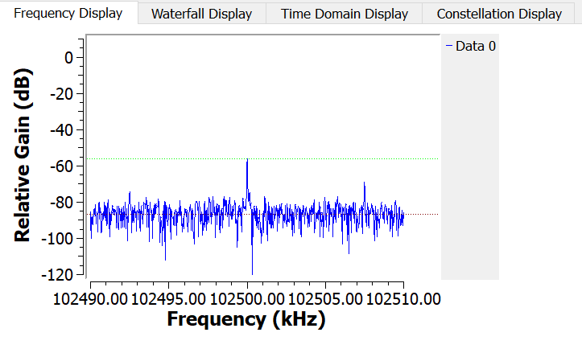
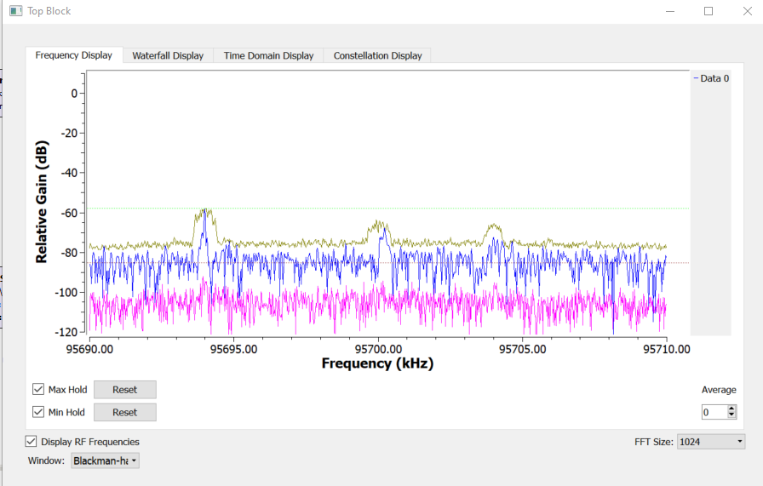
Frequency Modulation/ Display
Reduce noise and improve quality of radio reception
Focus on Center Frequency

Slide 21
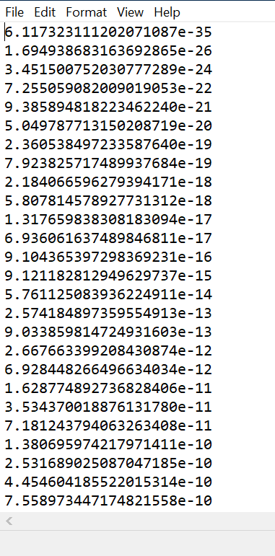
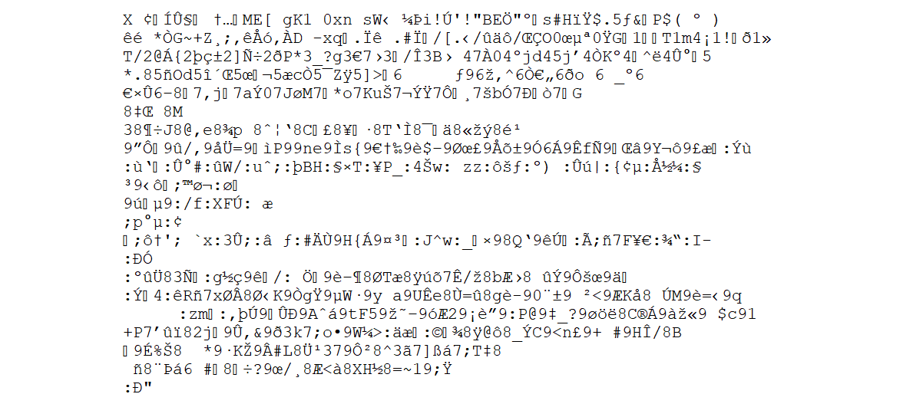
Python GNU File_Sink Conversion
After conversion
Binary from GNU Radio

Slide 22


